Slide 1
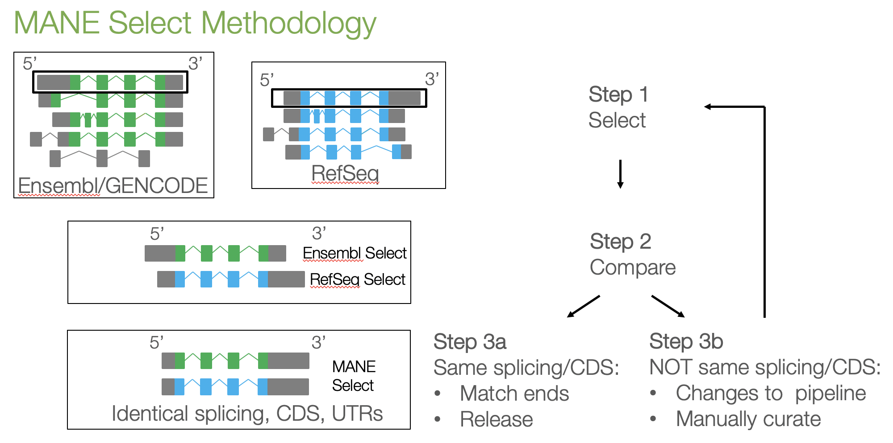


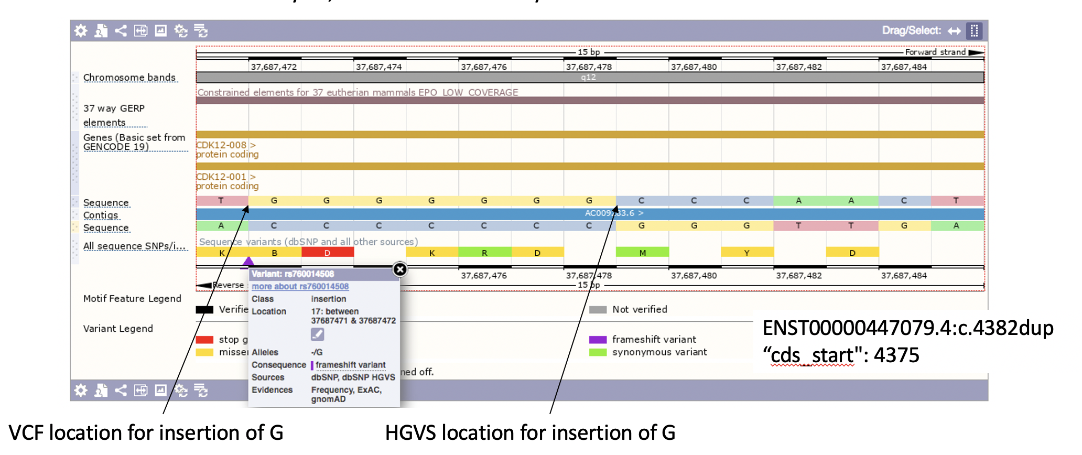


Ensembl Variant Effect Predictor – flexible and consistent molecular consequence prediction
Irina M. Armean, Laurent Gil, Diana Lemos, Andrew Parton, Helen Schuilenburg, Anja Thormann, Sarah E. Hunt, Paul Flicek, Fiona Cunningham
European Molecular Biology Laboratory, European Bioinformatics Institute, Wellcome Genome Campus, Hinxton, Cambridge, CB10 1SD, United Kingdom
Ensembl Variant Effect Predictor (VEP)
Transcripts Sets
The prediction of molecular consequence of a variant is essential for both basic and clinical research.
The Ensembl VEP:
Open-source toolset for genomic variant annotation and interpretation
Uses the extensive Ensembl transcriptomic, regulatory and variation data to predict consequences of variants
Reports allele frequency data from reference projects and results of multiple pathogenicity predictors
The Ensembl VEP can annotate variants using Ensembl/GENCODE, RefSeq and custom gene annotation.
Standardised reporting is one of the aims for the RefSeq and Ensembl joint MANE (Matched Annotation from NCBI and EMBL-EBI) project. The MANE Select transcript set is to include one well-supported transcript per protein coding locus.
In Ensembl release 101 80.4% of protein coding genes and 91.6% of all ACMG59 genes have a MANE select transcript.
Data used for transcript selection:
Ensembl/GENCODE: conservation, expression, length, representation in UniProt and RefSeq and clinical information if available.
RefSeq: expression, conservation, representation in UniProt and Ensembl, length, prior manual curation (LRG)
VEP reports MANE
Standardisation
Standardised reporting is crucial for data sharing across tools and platforms and having a community agreed approach is essential.
Variant consequences are reported using Sequence Ontology terms
The output is in standardised VCF format agreed with SnpEff and ANNOVAR
Participant in the GA4GH Variant Representation and Variant Annotation work groups
Allele normalisation
Sharing and merging data from multiple sources such as allele frequencies and phenotypic annotation relies on unambiguously defined variants and their allele’s representation.
Despite its crucial role, there are different ways one can perform allele normalisation especially for insertions and deletions in repeat regions.
For example:
VCF: left aligned
HGVS: 3’ aligned
New in VEP: The VEP ‘–-shift_3prime’ option will right align variants relative to their associated transcripts prior to consequence calculation.
2.5% of ClinVar alleles would be shifted
Impact of transcript choice
VEP shift_3prime
Variant molecular consequence prediction is highly dependent on the transcript set used. It is therefore crucial to use all transcripts to not miss any possible annotation!
Experiment: given different protein coding transcript sets, how many of the pathogenic (P) or pathogenic and likely pathogenic (PLP) ClinVar variants will be annotated as missense or protein truncating variants (PTVs)?
The highest coverage of 95.5% is achieved when all transcripts for a gene are used compared to using only the canonical transcript 95.1% or longest transcript 93.5%.
Left: percent of pathogenic and likely pathogenic variants annotated as missense or PTVs based on different transcript sets.
Data: ClinVar VCF release 24.08.2020, transcript sets Ensembl release 101
https://www.ensembl.org/info/docs/tools/vep/script/vep_options.html
Access points
The Ensembl VEP tool functionality can be accessed via multiple routes:
The Ensembl REST API using the VEP endpoint
Using the VEP web interface
Using the command line tool
https://rest.ensembl.org/
https://www.ensembl.org/vep
Genomic coverage of different protein coding transcript subsets in respect of the genomic regions annotated as within protein coding transcripts in Ensembl release 101 (left) and in relation to the golden path for GRCh38.p13 (right).
Ensembl receives majority funding from Wellcome (grant number WT108749/Z/15/Z) with additional funding for specific project components from the National Human Genome Research Institute (U41HG007823 and 2U41HG007234), the Biotechnology and Biological Sciences Research Council (BB/N019563/1, BB/M011615/1, BB/S020152/1, BB/P016855/1, BB/S02011X/1 and BB/P024602/1), Open Targets, Wellcome (WT104947/Z/14/Z, WT200990/Z/16/Z, WT201535/Z/16/Z, WT108749/Z/15/A, WT212925/Z/18/Z, WT218328/B/19/Z, WT201535/Z/16/Z), British Council (414710385), ELIXIR: the research infrastructure for life-science data, and the European Molecular Biology Laboratory. This project has received funding from the European Union’s Horizon 2020 research and innovation programme under grant agreement n° 733161 (MultipleMS), n° 731060 (INFRAVEC2), n° 825575 (EJP RD), n° 817923 (AQUA-FAANG), n° 817998 (GENESWitCH) and n° 815668 (BovReg). We also receive funding from the 'Save the Tasmanian Devil Program'.

